Slide 1

CultureGrams 101: Discovering the World Around You
2023

Slide 2
Session Objectives
Navigate topics using Guided Research
Support K-12 Country and State report assignments
Analyze country data using tables, charts, and graphs

Slide 3
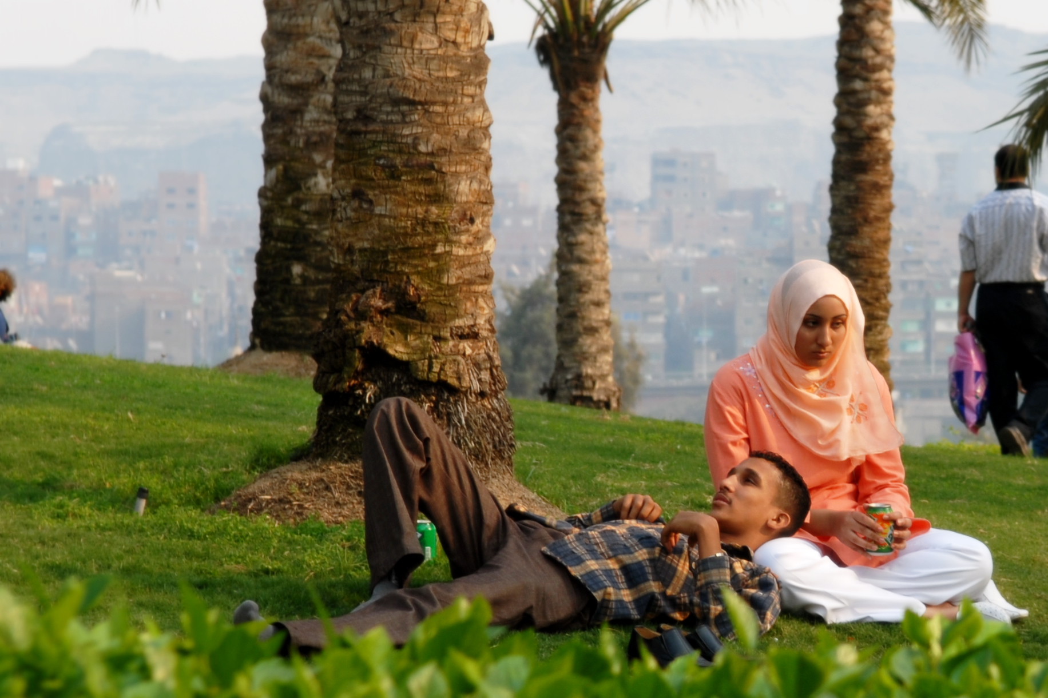
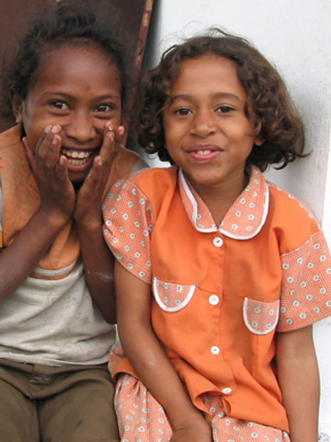
CultureGrams Overview
Unique cultural content written and reviewed by in-country experts and supplemented by downloadable multimedia, interviews, recipes and more
25 categories covered including customs, traditions, politics and daily life
Includes a Kids Edition, a more visual, engaging and age-appropriate report collection for over 200 countries
U.S. States and Canadian Provinces Editions offer timelines, cultural notes and current almanac-type information about all 50 states and 13 provinces
Notes:
What is CultureGrams? It is a database of unique cultural content that is written and reviewed by in-country experts and supplemented by downloadable multimedia, interviews, recipes and more. It has 25 categories that cover customs, traditions, politics and daily life. It is divided into four editions, which are the world edition, states edition, provinces edition, and a kids edition that contains age-appropriate content for over 200 countries. All four editions offer timelines, cultural notes, and general information about their respective states, countries, or provinces.

Slide 4
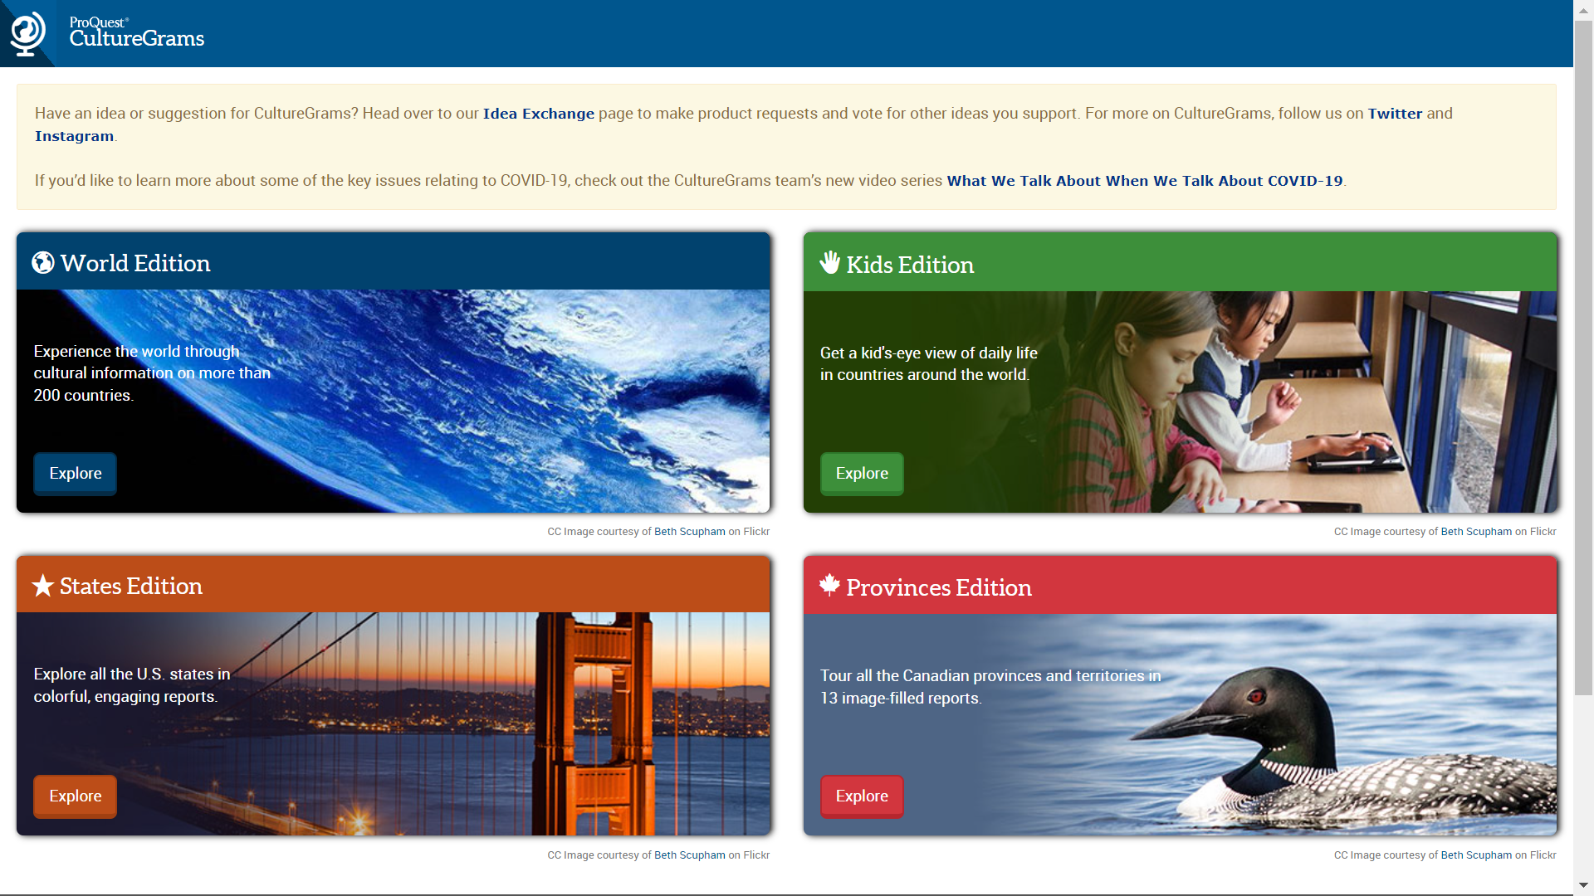
Landing Page
MS
HS
ES MS
ES MS
ES MS
Notes:
This is the Landing page, where you can click to select which edition you’d like to browse. The World Edition is targeting Middle School and High School students, while the Kids, States and Provinces editions support upper Elementary and Middle School reading levels. These grade levels also match when the assignments are typically done; for example, States report is mostly Elementary and Country Report mostly middle or higher. Of course, your mileage may vary, and one of the strengths of this product is that all of the editions are set up the same way, so users can comfortably move from one to the other.

Slide 5
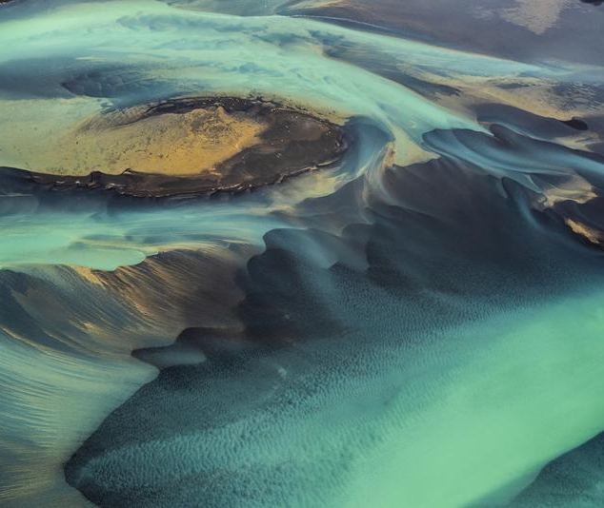
World Edition

Slide 6
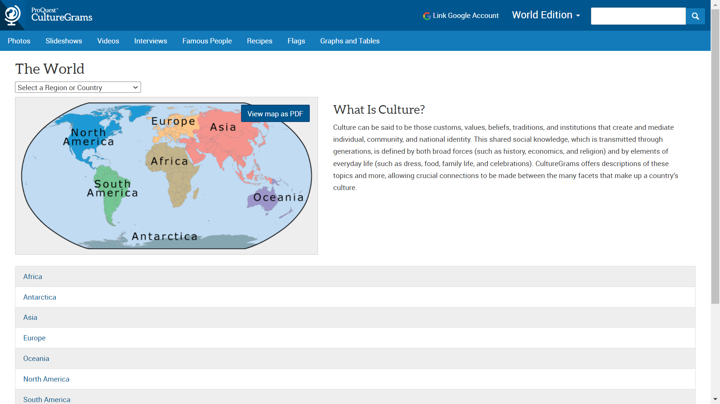
World Edition Landing Page
Notes:
Let’s start off today by looking at the Landing Page for the World Edition. There are multiple ways to navigate to which country you’d like to take a look at, the first being the map based navigation with the option to use an alphabetical pull down in the upper lefthand side. You also have the ability to navigate by the ‘Gallery’ options at the top of the page rather than by country. For example, if you just want to view Interviews you can click right on that tab and view a list of interviews for every country. And of course, you have the option to use the search bar in the top right corner to do a basic search. I also want to quickly point out the ability to link a Google Drive account is up in this corner as well.

Slide 7
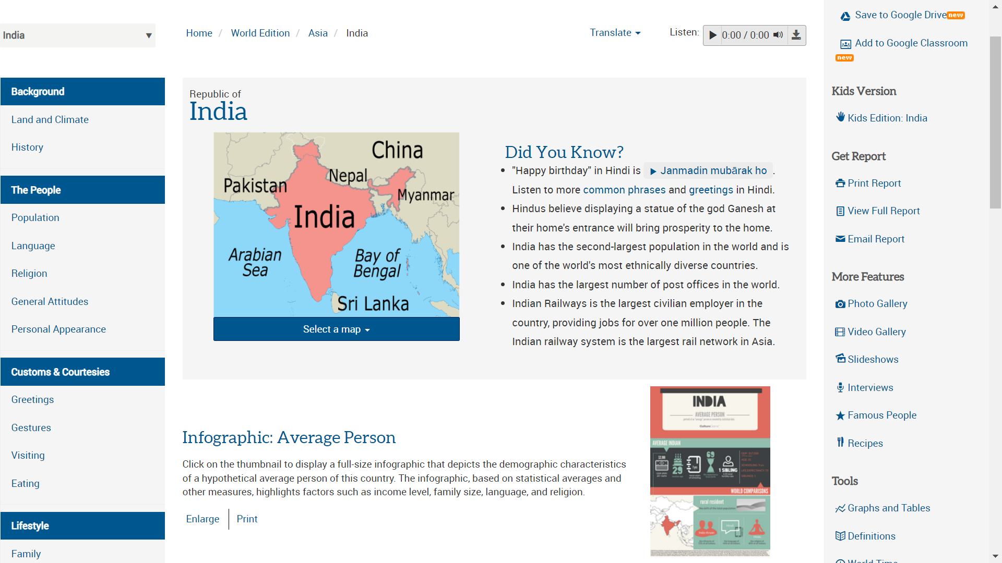
Country Report: India
Notes:
As an example today, I’ve selected the World Edition India Report, and as you can see there is a lot of information on this page. On the left you’ll find many categories for various types of cultural information. On the far right you’ll find the access to different versions of the report (Print PDF, email reports, etc.) and also supplementary features such as photo galleries, famous people, and graphs and tables. At the top are two important Tools: the translate button, to translate the page into multiple languages, and a Text-to-speech feature that allows the user to have the report read to them. You also have the ability to download the audio as an mp3 file and save it, to listen to it later. And the last thing I’d like to point out on this page is the Average Person Infographic towards the middle. This is a very popular feature that supports visual literacy, and each report has one.

Slide 8
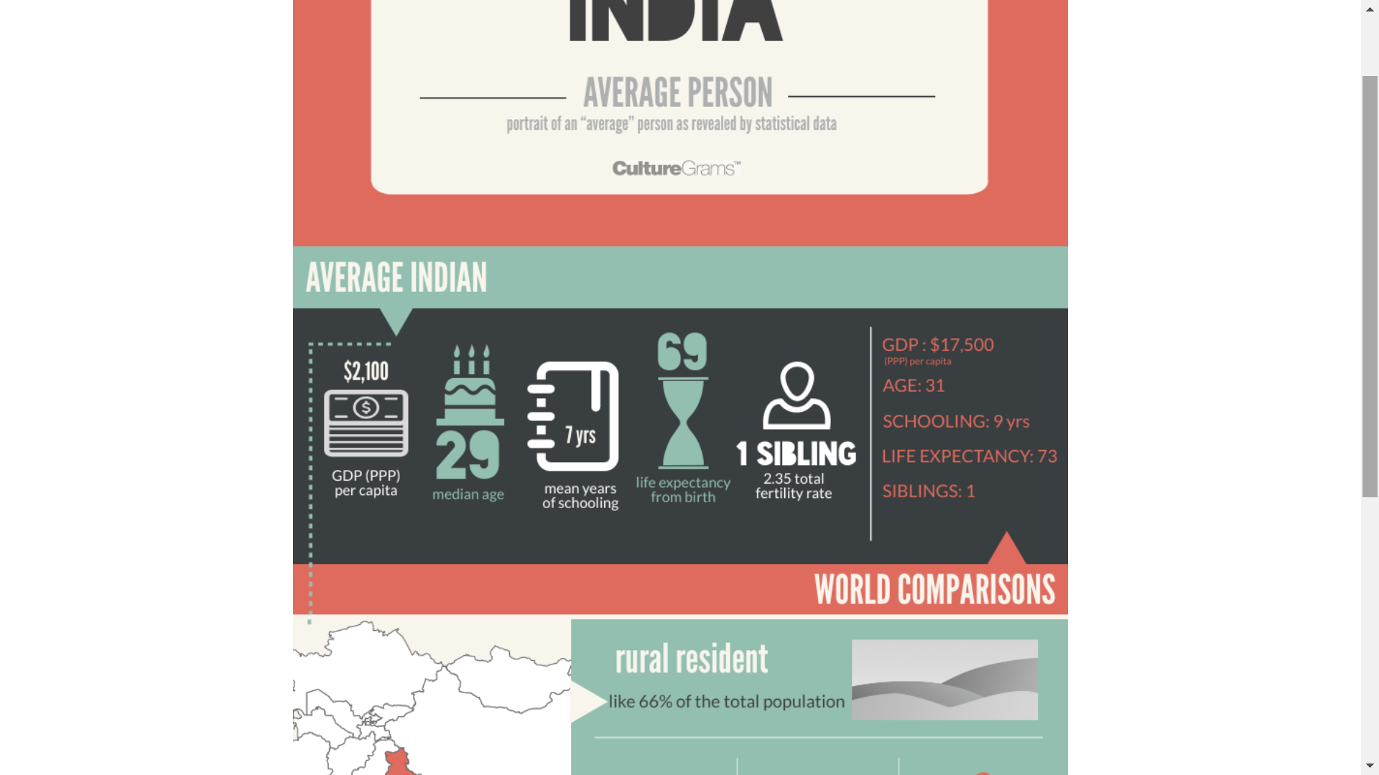
Infographic
Notes:
And here’s a closer look at the Average person infographic – it compares with World averages and is updated annually. Further down shows statistics such as rural/urban distribution, dominant language, religion, etc.

Slide 9
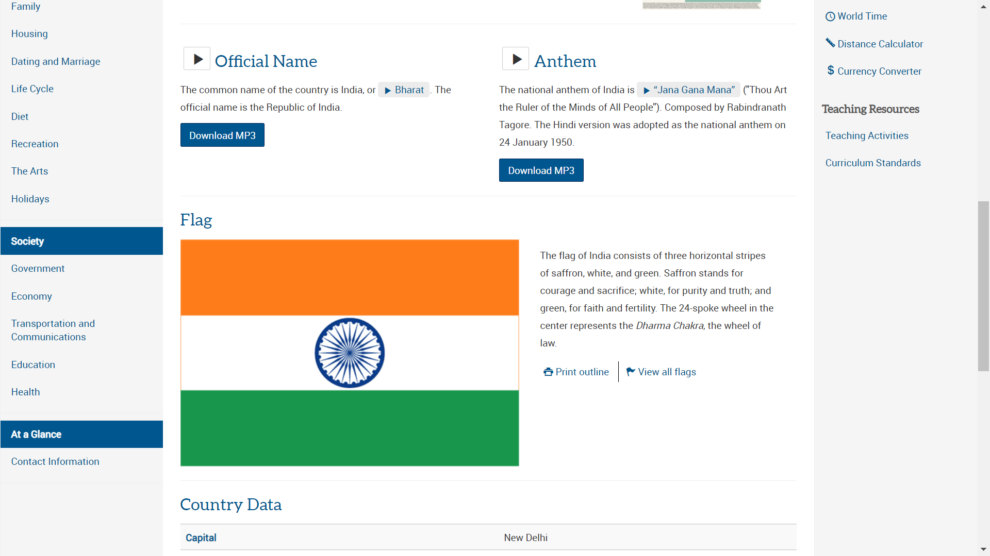
Country Report: India
Notes:
Back to the India World Edition report. Scrolling further down the page, you can see items such as audio files of the official name being pronounced and a recording of the National anthem. We’ve also got a number of different flags and even more cultural categories on the lefthand side.

Slide 10
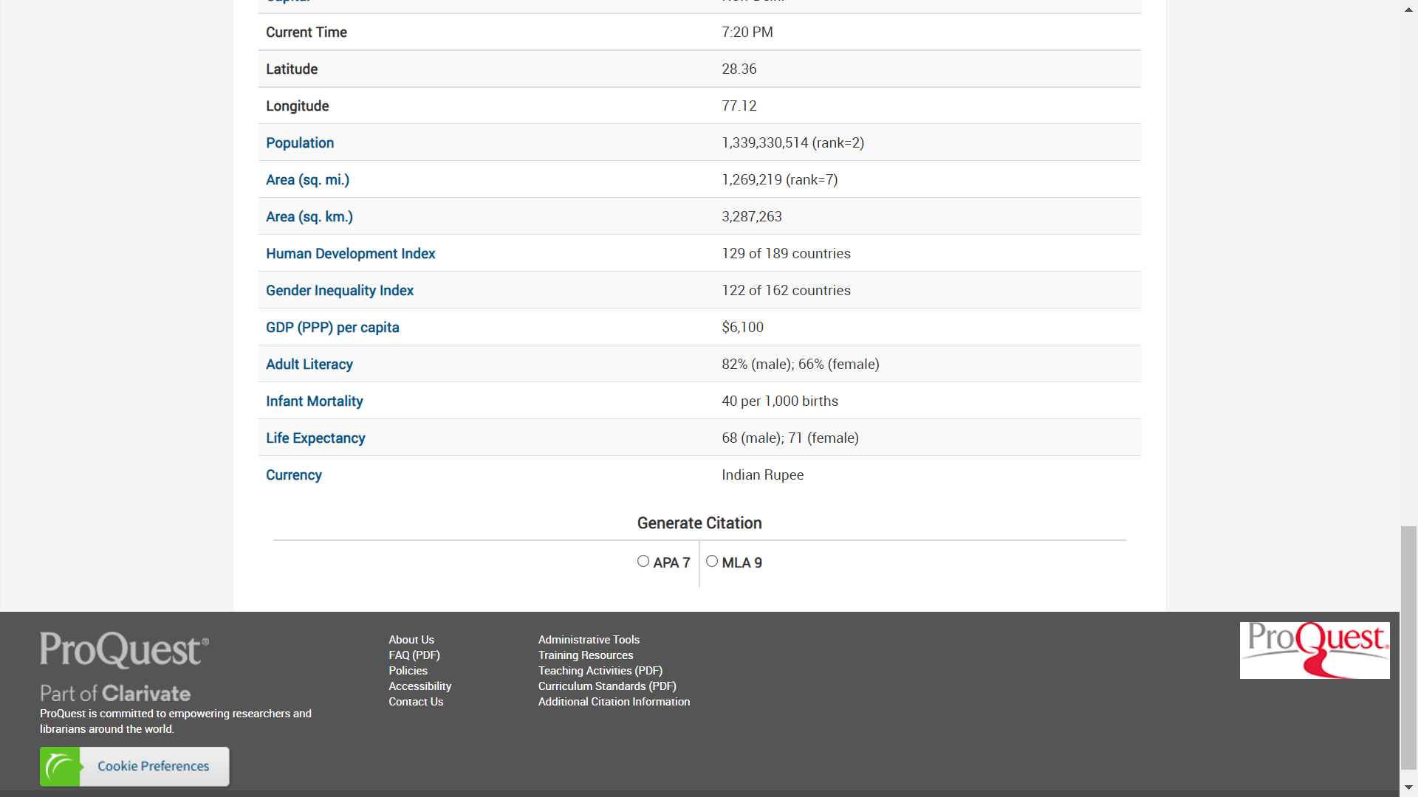
Country Report: India
Notes:
Scrolling to the very bottom of the India World Edition report, you’ll find vital statistics. You’ll note that some are hyperlinked to tables with global numbers for comparison purposes. There is also where you will find the citation generator, where you can select either of the latest versions of APA and MLA.

Slide 11
More Features
Notes:
Now we’re going to take a look at the features located on the right side of the page. Scrolling back to the top of the India Report, let’s go ahead and take a look at the Photo Gallery.

Slide 12
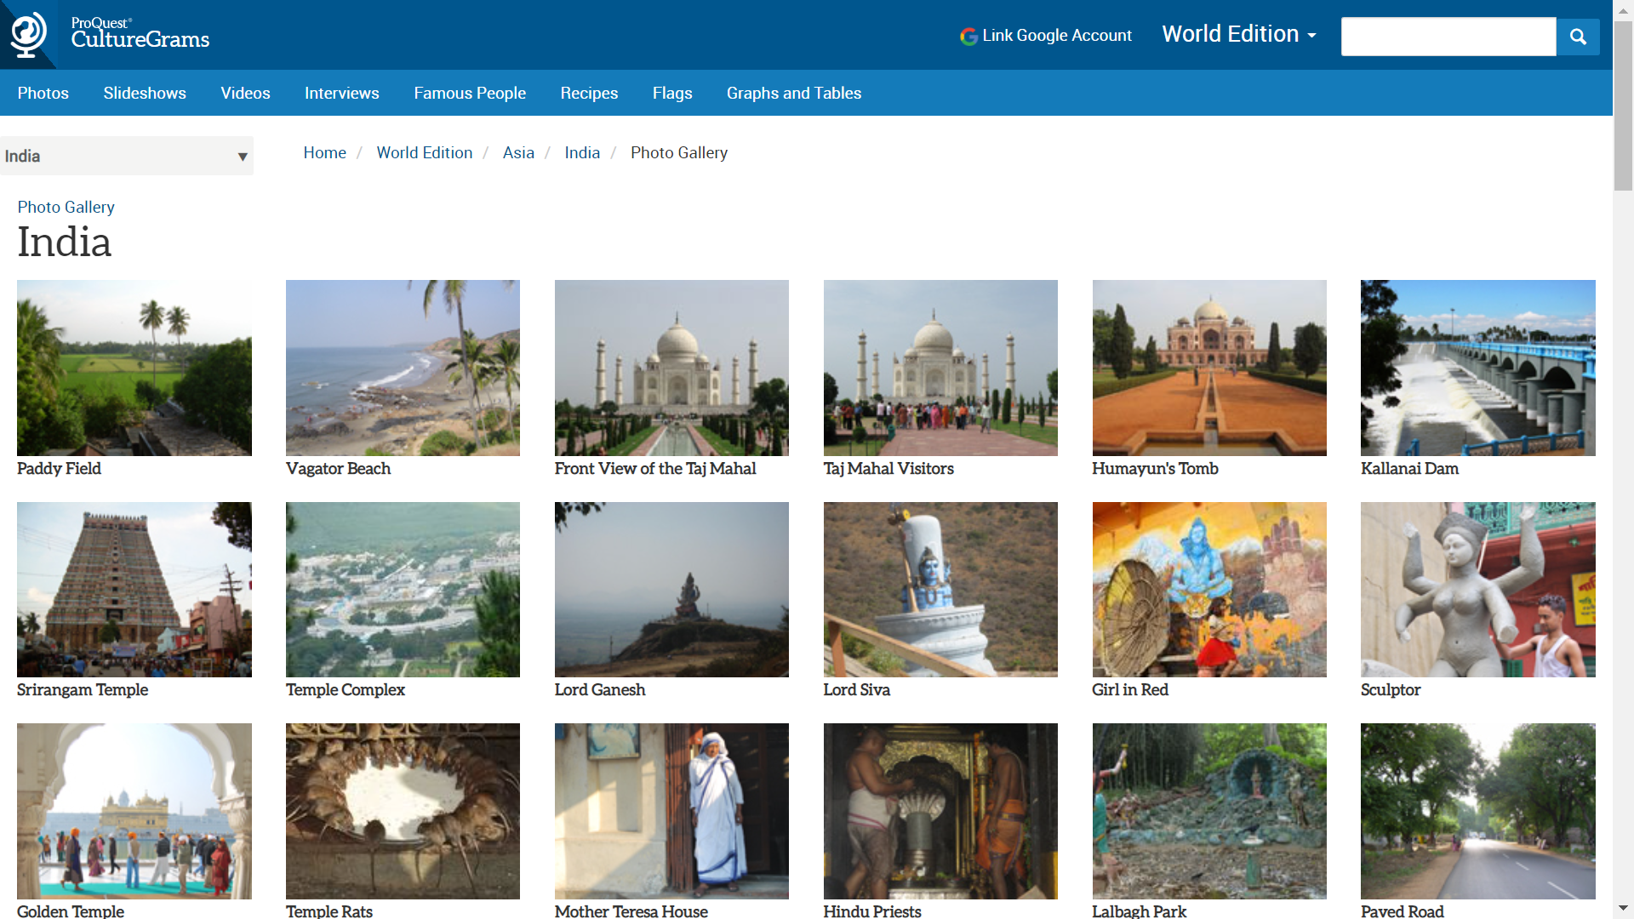
Photo Gallery
Notes:
This is the photo gallery for India. Many of these photos are proprietary to ProQuest and some are licensed. All the photo rights have been cleared for use in student assignments. There are different categories for users to search through, to help narrow down the subjects of their photos.

Slide 13
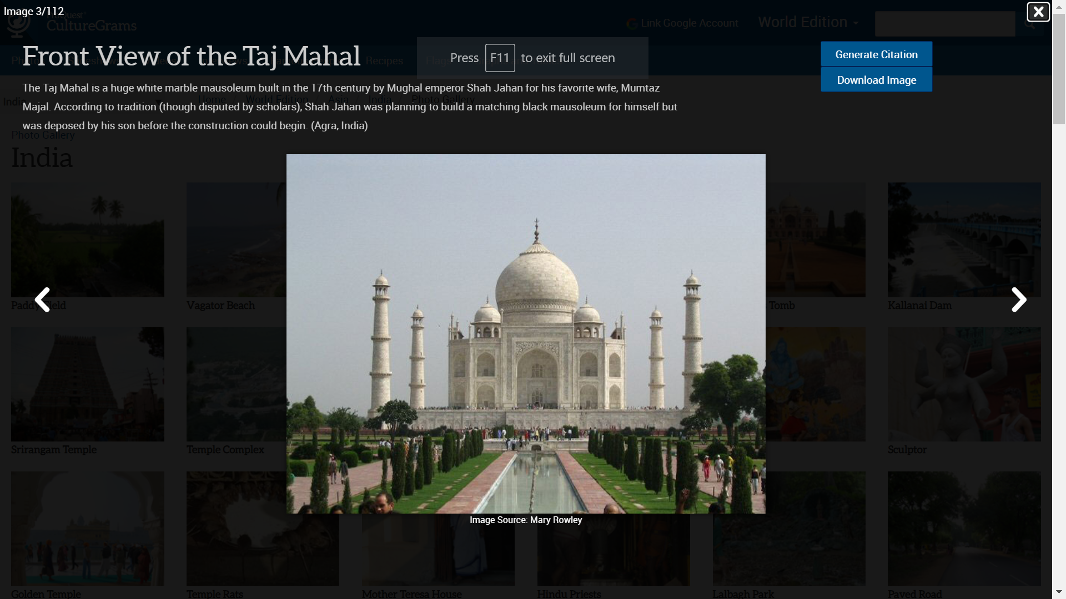
Photo View
Notes:
Here is a lightbox image of one of the photos from the India Photo Gallery. There will always be a caption at the bottom of the photo itself, as well as a ‘generate citation’ button up in the top right. Underneath that is the download image button, which facilitates image use by students.

Slide 14
More Features
Notes:
Back to the India World Edition page, let’s now click on the link to the Video Gallery for India.

Slide 15
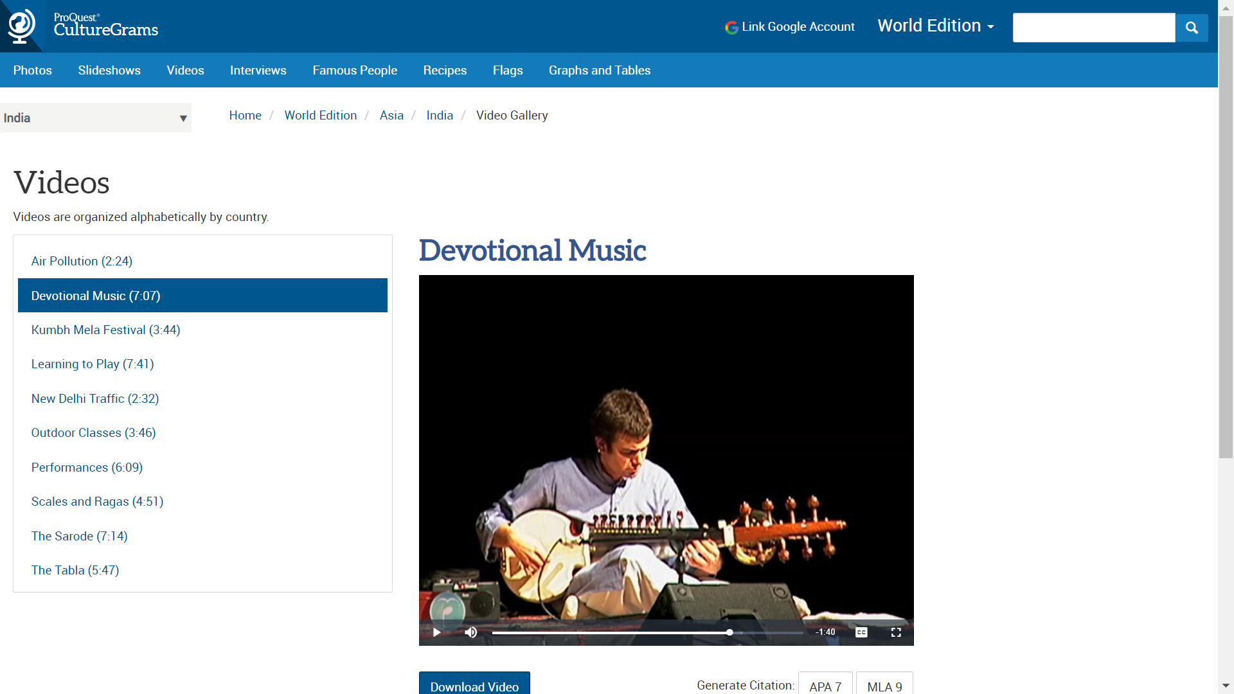
Videos
Notes:
Here is the video display page. These are short videos that typically run around 10 minutes pr less and showcase daily life. As with the photos, you have the ability to download videos, as well as the ability to generate citations. Some of the videos also include captions.

Slide 16
More Features
Notes:
And back to the India page World Edition. Now let’s take a look at the slideshow link.

Slide 17
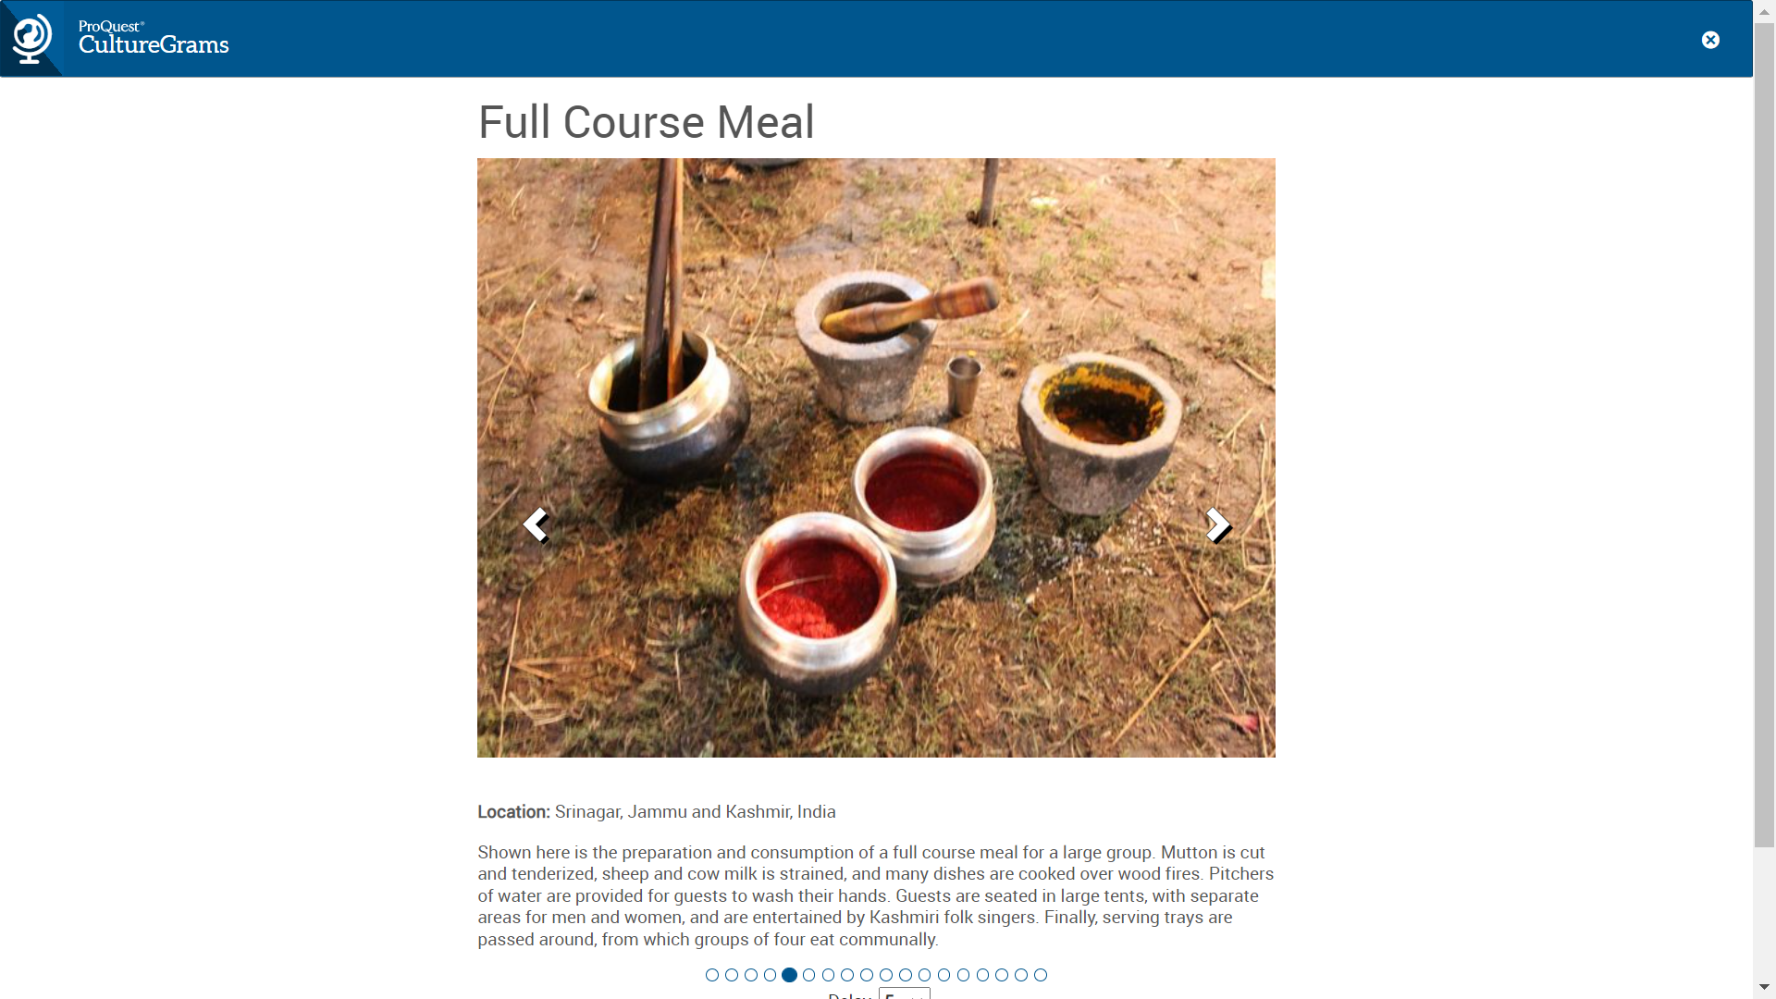
Slideshows
Notes:
Here is the slideshow page for India, and we’re looking at one of several slideshows. Each slideshow has a theme, this one pertaining to food. It includes images and text, and it advances every few seconds or manually. As with the videos, these can also be cited.

Slide 18
More Features
Notes:
And again, we’re back again to India World Edition page. Next up is one of my favorite features, the interviews.

Slide 19
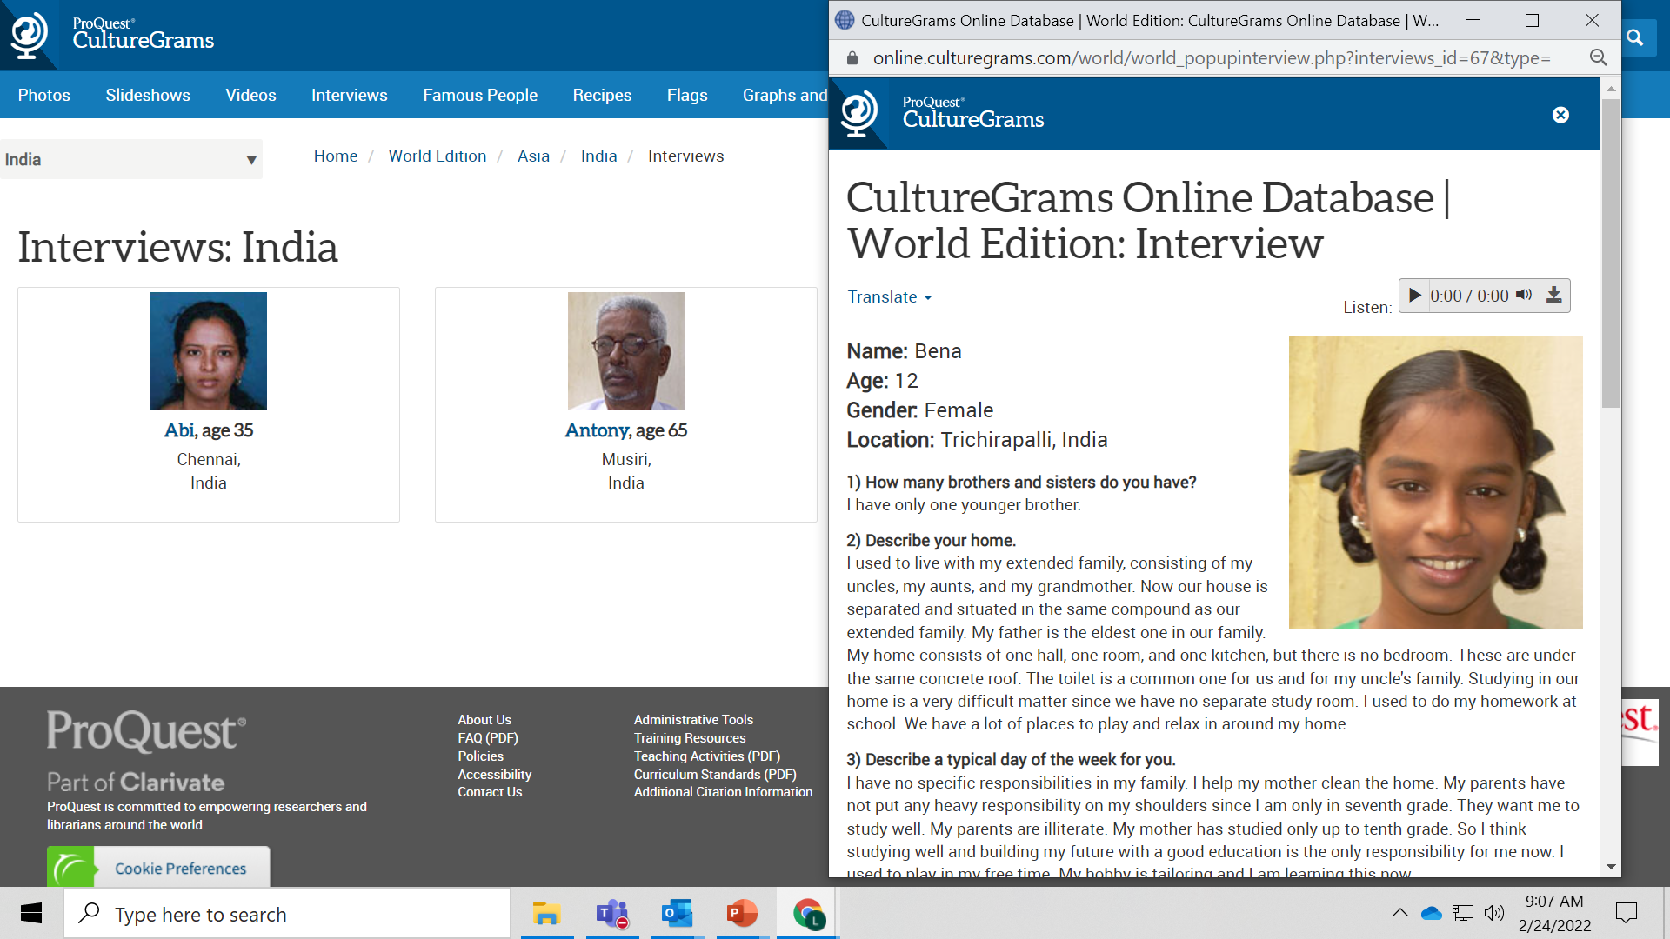
Interviews
Notes:
Our interviews are unique to ProQuest and feature a variety of people of all ages, ethnicities, and experiences. Editors ask the same questions of each subject, and their answers help students to understand what life is like for someone in another country, which fosters cross-cultural comparisons.

Slide 20
More Features
Notes:
Next up on our features list is the Famous People link.

Slide 21
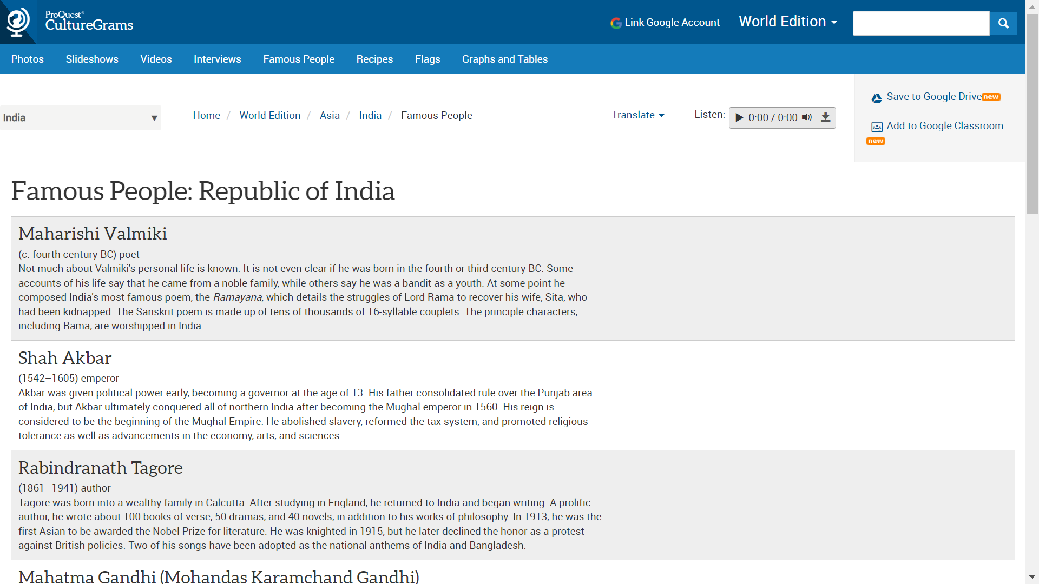
Famous People
Notes:
The famous people page contains short biographies of some of the most famous people from a given country. This gives just enough to get a basic understanding of who the individual was, when they lived and why they are considered famous.

Slide 22
More Features
Notes:
Our last feature is also one of the most popular ones, the recipes feature.

Slide 23
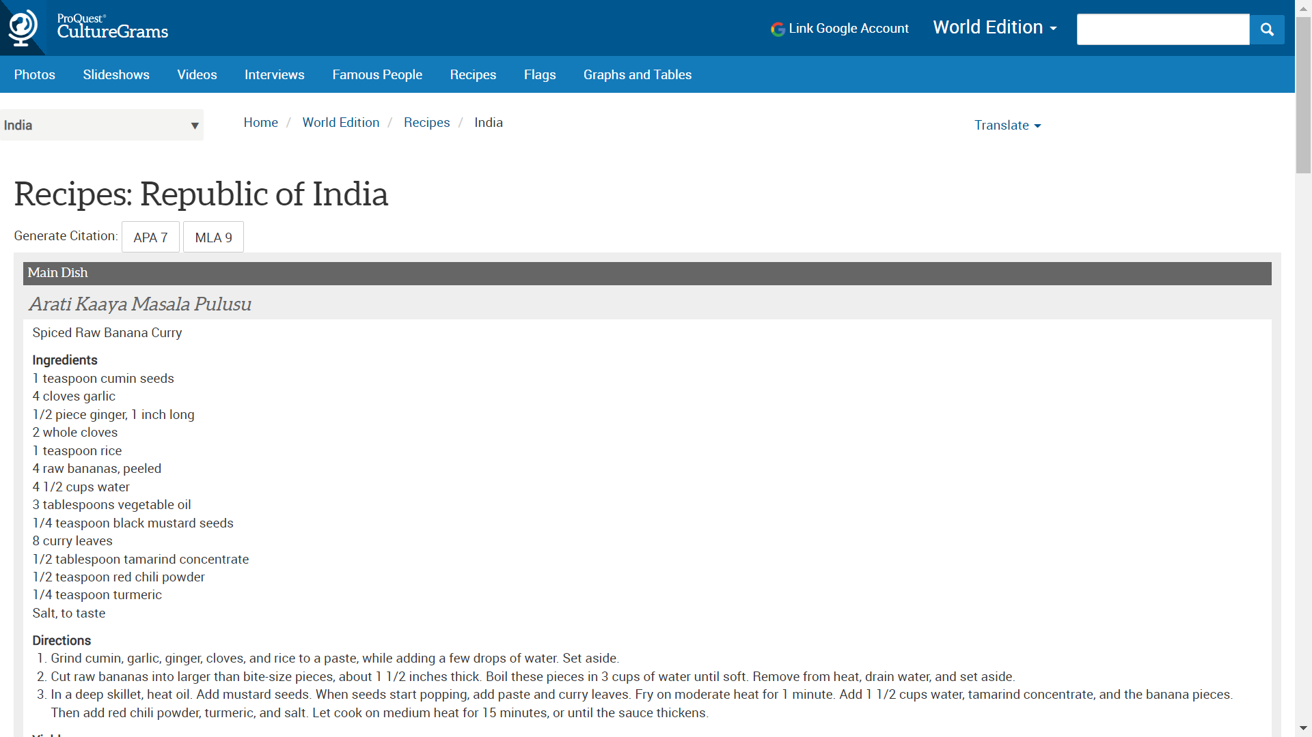
Recipes
Notes:
Full recipes are provided by our cultural contacts in the country. These are helpful for those schools that have a world culture food fair and students make and share the recipe for one or more countries.

Slide 24
Tools
Notes:
So now that we’ve taken a look at all of the features for this country’s page, let’s turn our focus to some of the tools. The one I’m going to click on now are the Graphs and Tables.

Slide 25
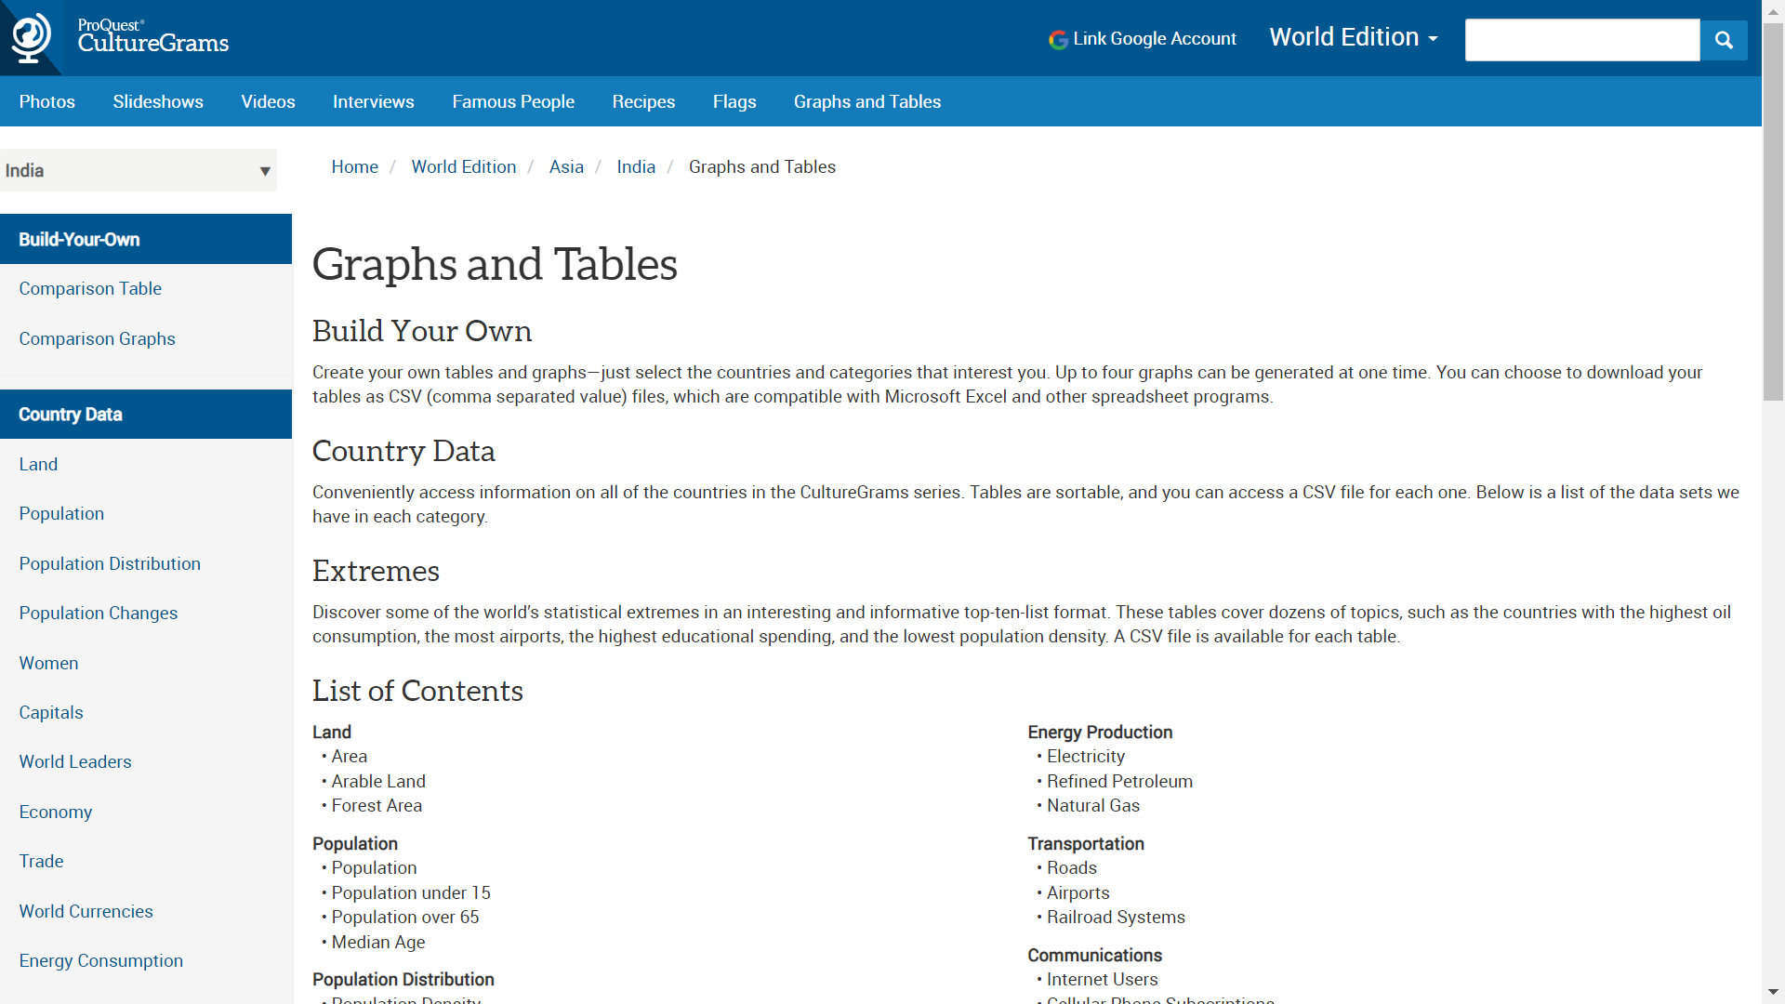
Graphs and Tables
Notes:
The graphs and tables are updated with statistics by our CultureGrams editors. These tools offer an opportunity for students to sharpen their numeracy skills. There are two options available in the column on the left of the screen. The first, on the top, shows country data on major demographic categories. Each link takes you to a page of countries and you can compare the statistics there. The second option allows students (or teachers) to build their own table or graph by selecting a few countries and a few demographic categories.

Slide 26
Cultural Content
Notes:
We are back once more to the India page, because I want to take a quick look at the Cultural content. I’ll select Personal appearance to take a look at here -

Slide 27
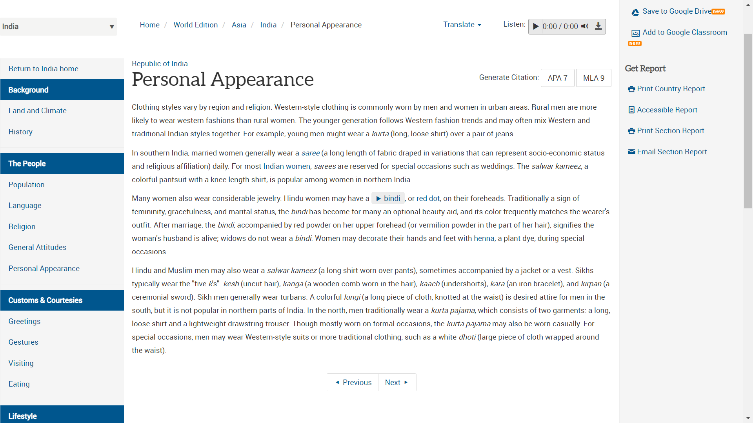
Personal Appearance
Notes:
As I mentioned before, the cultural content is provided to us by natives or long-time residents of a country. I want to point out several features on this page: the first is that these pages include in-text links to images in CultureGrams that relate to the word in question. Also included are links to in-text audio files to hear words pronounced by a native speaker that may not be familiar to students. Navigation buttons at the bottom of the page move through the various cultural headings for a particular country. And like before, there is the ability to generate a citation in either MLA or APA format for this section and you can click in the top right corner for these options.

Slide 28
Navigate to Kids Edition
Notes:
One more time, back to the India World Edition landing page. The red oval showcases that you can toggle to the Kids Edition version of the India report. This will have similar information, but organized for younger audiences.

Slide 29
Kids Edition

Slide 30
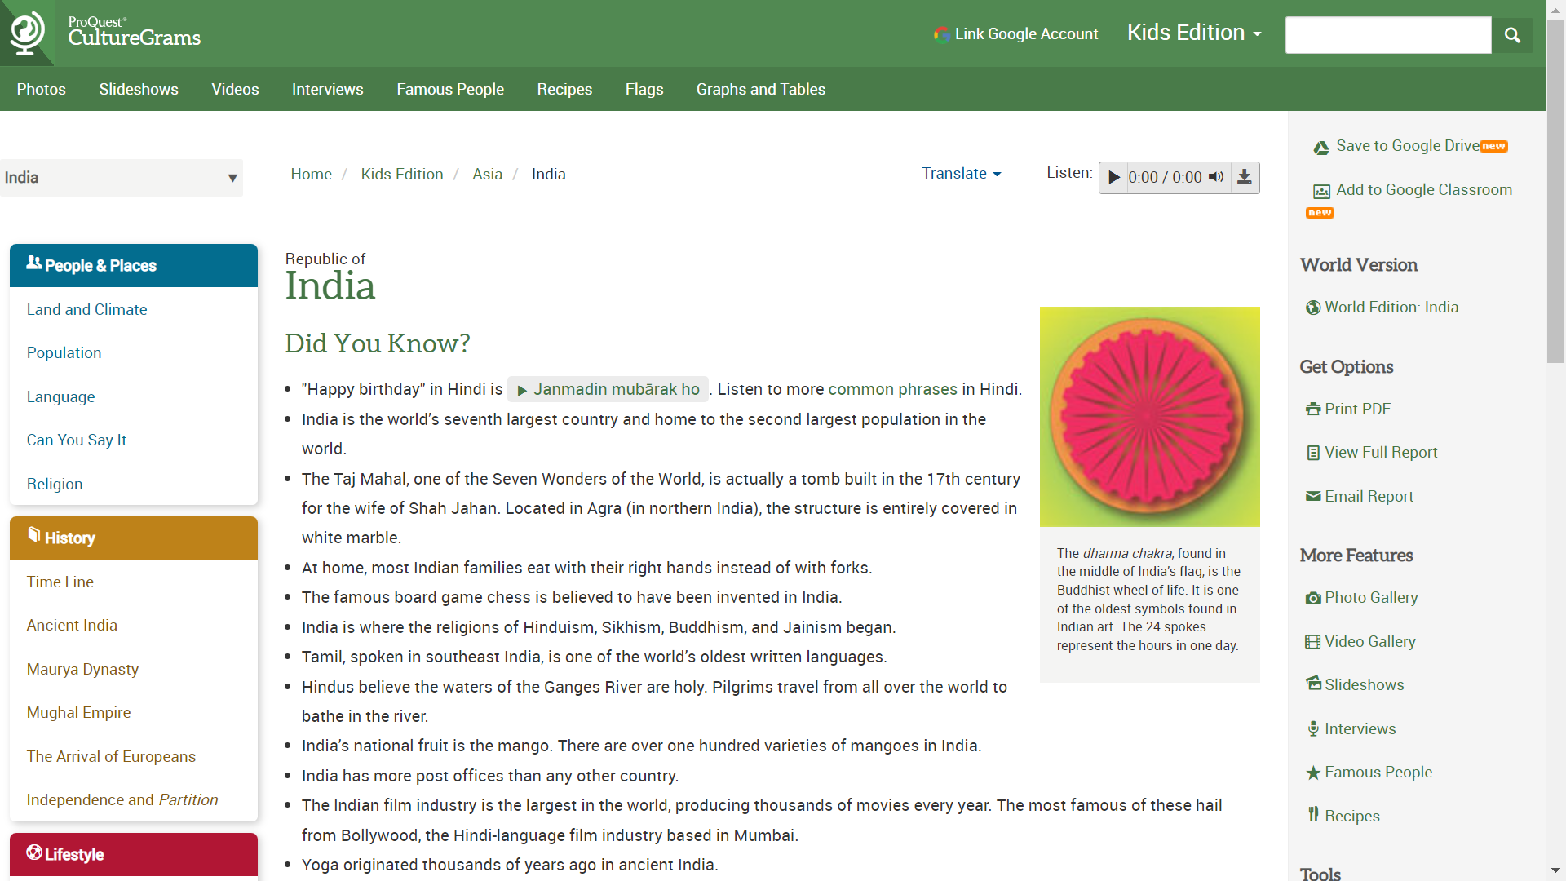
Kids Edition
Notes:
This is the India landing page in Kids Edition. The red oval shows the link for getting back to the World Edition version of this report. As you can see, this page has similar navigation to the World Edition, but is more colorful and some of the text is shorter and bulleted.

Slide 31
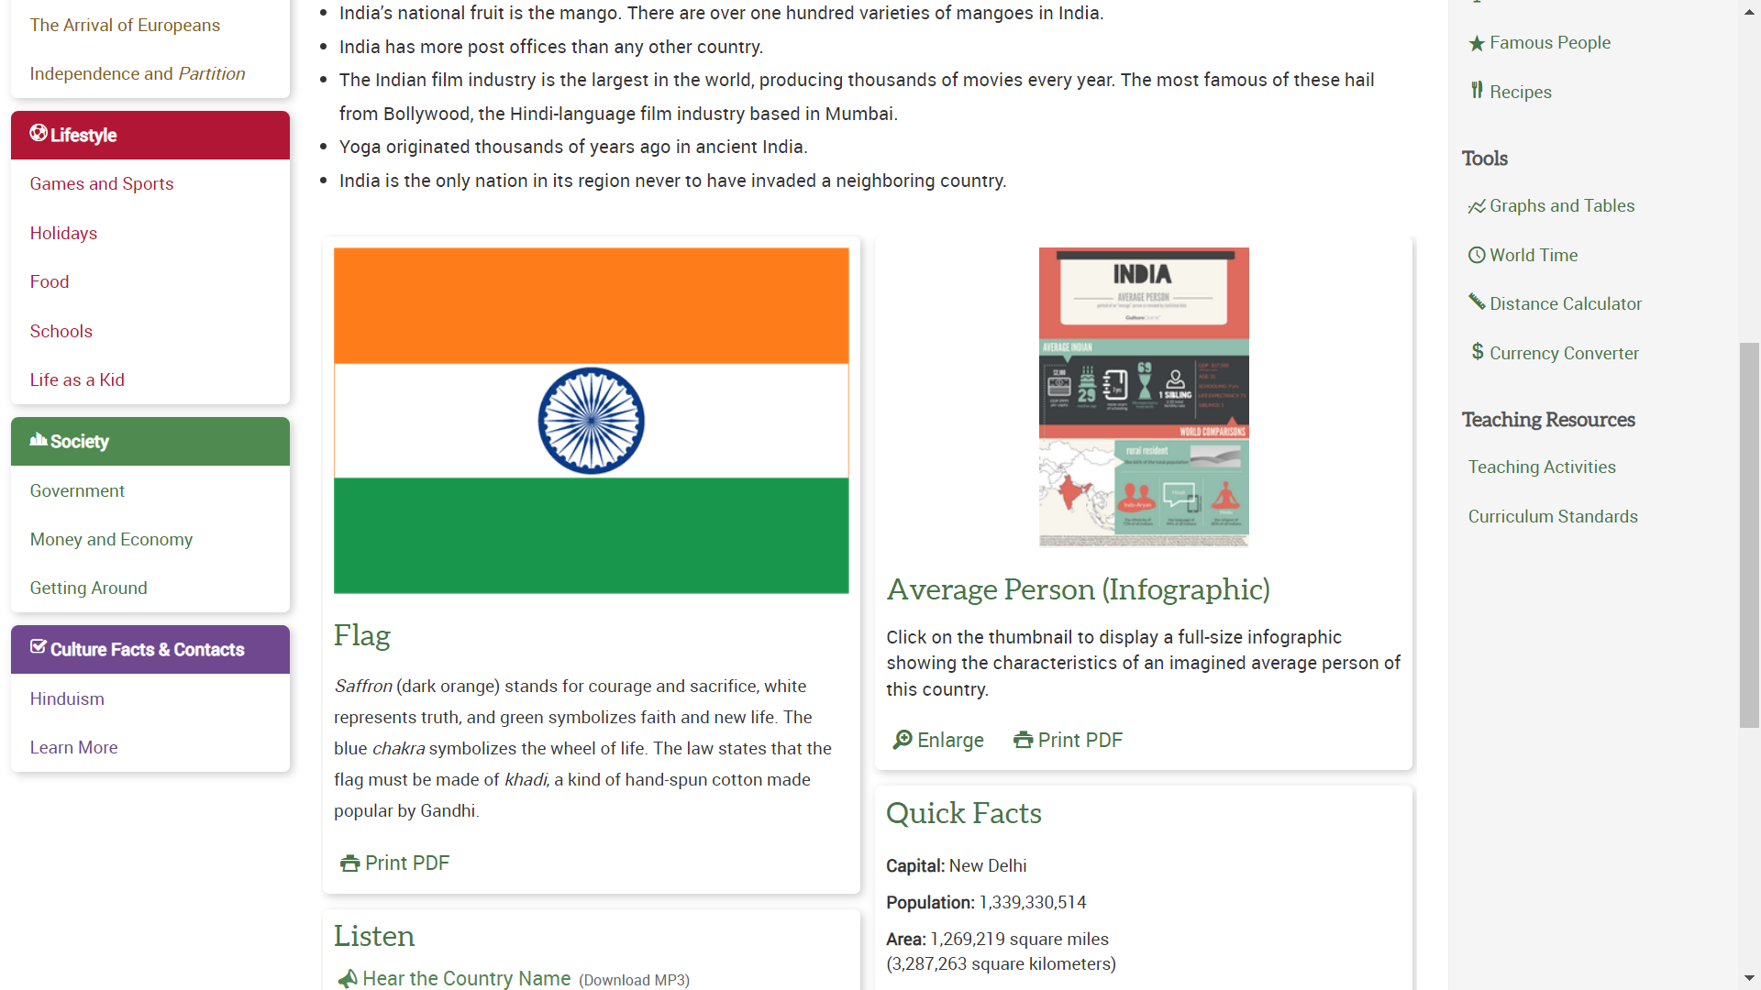
Kids Edition
Notes:
As we scroll down on the Kids Edition version of the India report, you’ll note the similarities – The Average Person infographic and the flag, the quick facts, etc. Since children are often curious how life is like for their peers in other countries, let’s click to take a look at the Life as a Kid page.

Slide 32
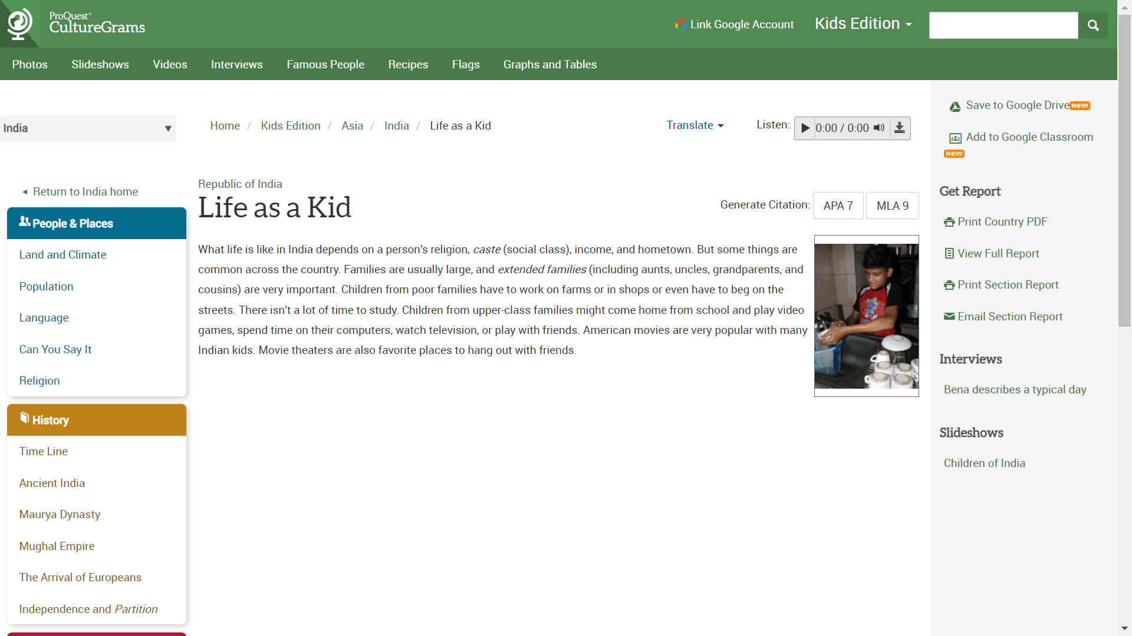
Life as a Kid
Notes:
From the link on the previous page, here it the life as a kid page. You’ll see that the content is shorter than on the World Edition page, and there are the same features as we saw in the World Edition such as translate, text-to-speech, and the citations. You’ll also see the links on the top of the page that will lead you to the interviews, slideshows, graphs and tables, etc.

Slide 33
States Edition

Slide 34
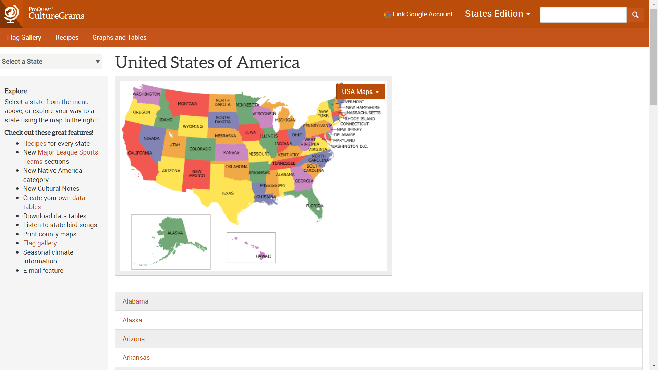

States Edition
Notes:
Very quickly, I want to show you the view for the States Edition. The change in color of the header indicates a different edition of the product. So now, instead of a world map, we see a map of the United States. Let’s click on the state of Georgia as an example today.

Slide 35
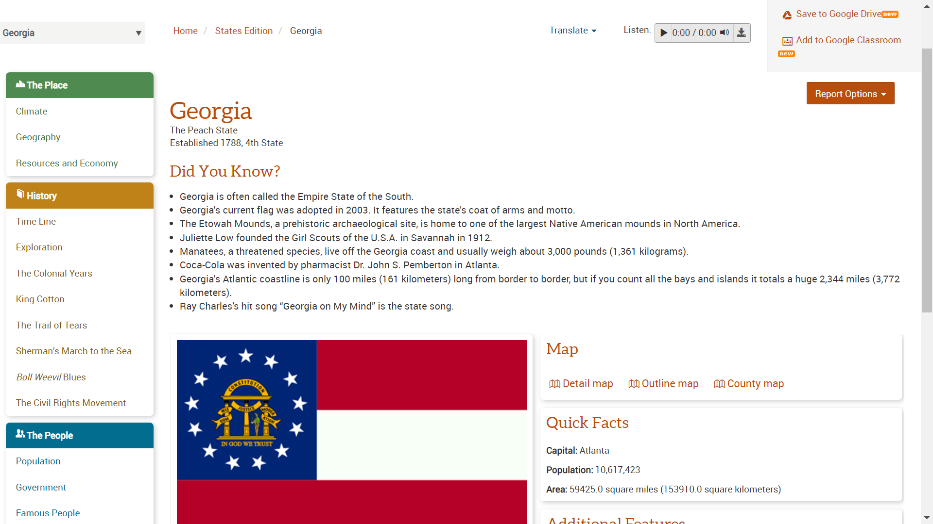
State Report: Georgia
Notes:
Here is the Georgia landing page. If it reminds you of the Kids Edition, there’s a reason for that – it’s set up to look similar because a common upper-Elementary assignment is to write about a state. The left hand navigation is similar to Kids Edition as well. Other report options found in other editions are visible here too.

Slide 36
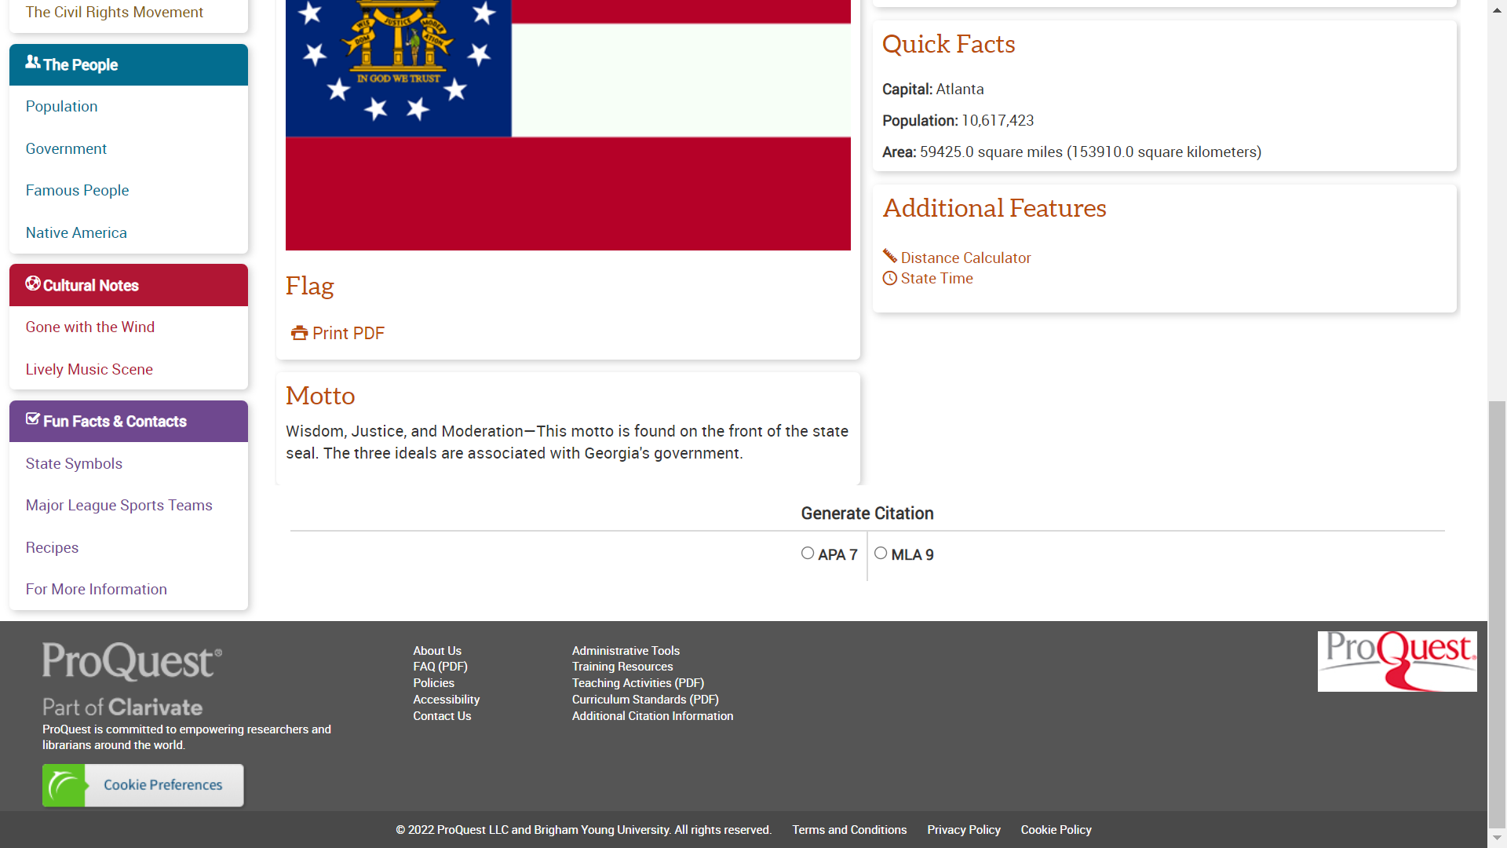
State Report: Georgia
Notes:
And this is scrolling further down on the U.S. States Edition pages. Again, the placement of the information is consistent with other editions: Same tools, same places.

Slide 37
Teaching Resources
Notes:
To finish up today, I want to point out on the right side of the screen you have a link called ‘Teaching Activities’. Clicking on this will open up a PDF -

Slide 38
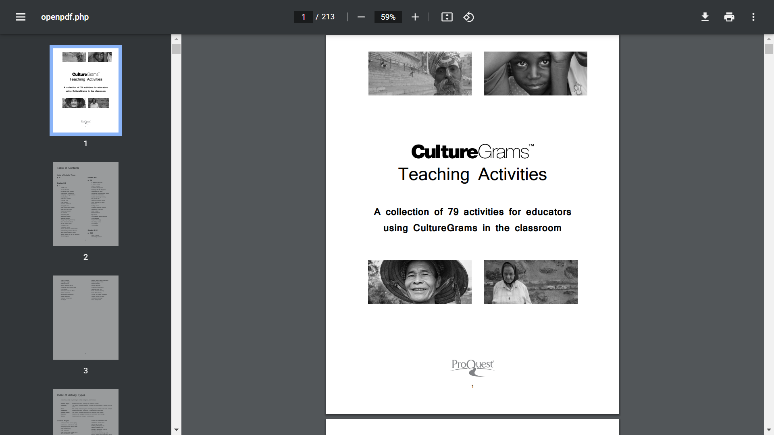
Teaching Activities
Notes:
- That looks like this. It is organized by grade range or activity type, and it includes full lesson plans including links back to the product section relevant to the activity. This PDF can also be found on the CultureGrams LibGuide.

Slide 39
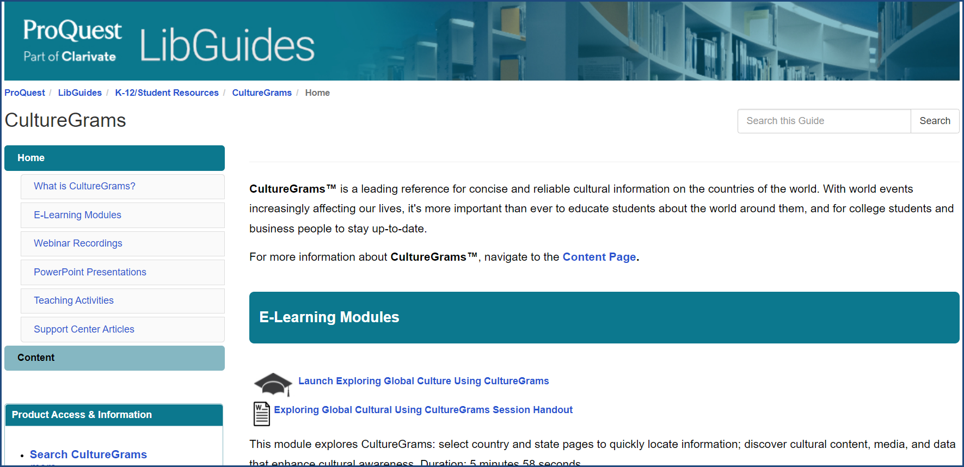
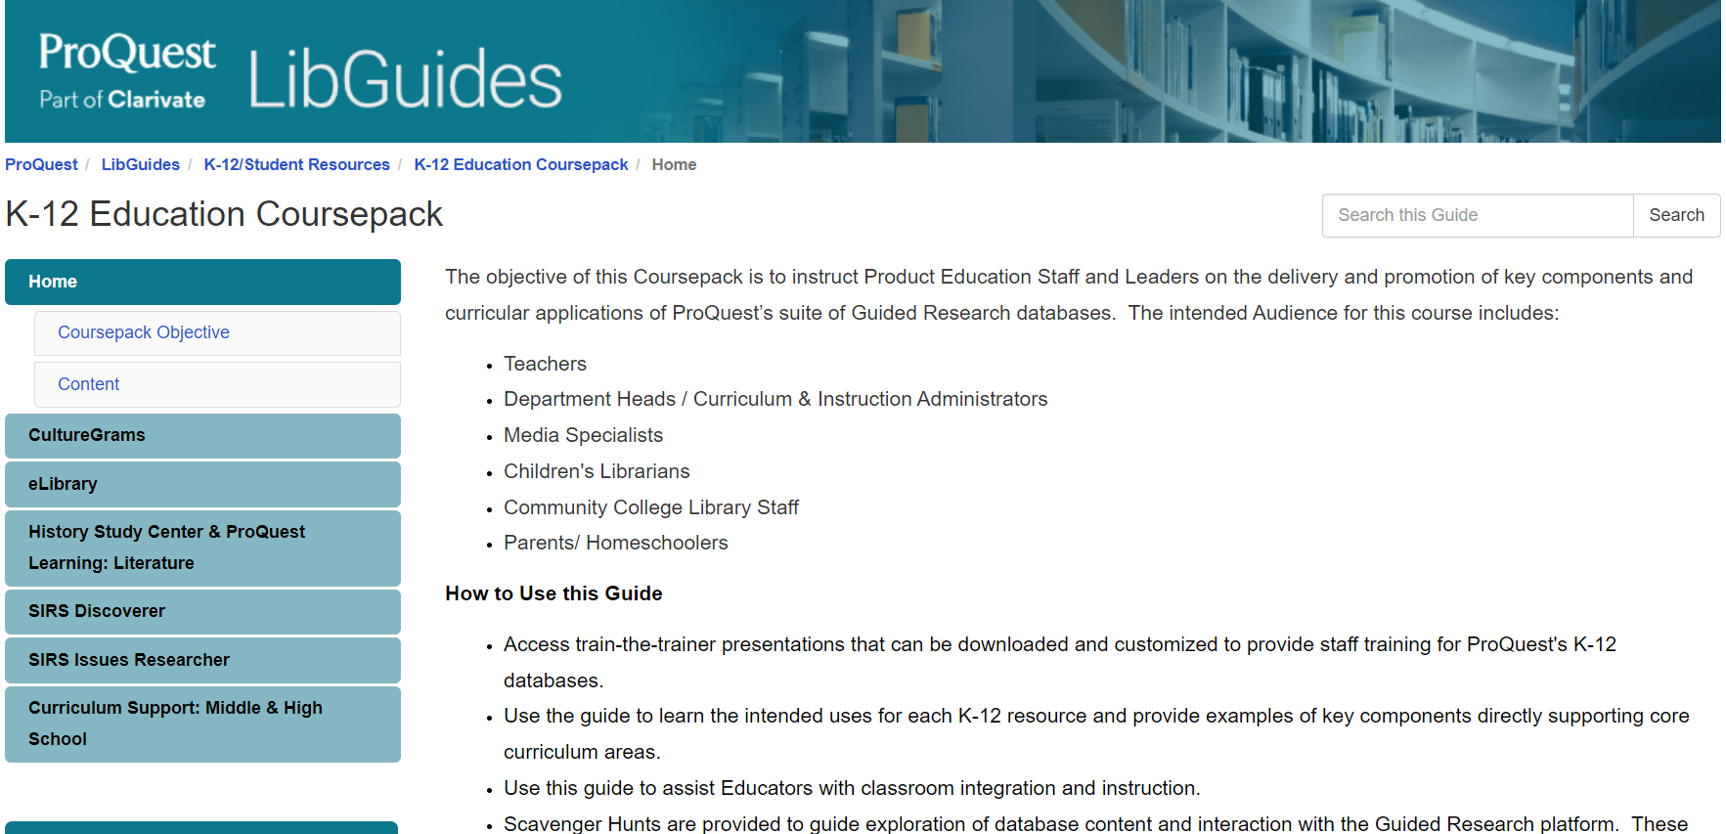
Additional Resources
Home - CultureGrams - LibGuides at ProQuest
Home - K-12 Education Coursepack - LibGuides at ProQuest
36
Notes:
If you’re interested in additional resources for this database, we have two related LibGuides. The first is the CultureGrams LibGuide, where you’ll find elearning modules, powerpoint presentations, and support center articles. We also have a K-12 Education Coursepack LibGuide, and this is where you will find teaching activities and handouts such as scavenger hunts. More content is in the process of being added, so please continue to check for new, fun items – I will include the links to both of these guides when I send out the recording for our session today.

Slide 40
Thank you
Questions?
training@proquest.com

